Slide 1
INFO 4307/6307 Comparative Evaluation of Machine Learning Models
Guest Lecture by Stephen Purpura
November 16, 2010

Slide 2
Question for You
When it comes to machine learning model comparisons, what is the difference between “Junk Science” and “Real Science”?

Slide 3
Answer (from economics)
"The key distinguishing feature of junk science is that it does not work out of sample, and that as the sample is extended beyond the one over which the specification search was originally constructed the statistical significance and substantive importance of the results drop off very quickly.”
-- Brad DeLong blog post
Notes:
Questions: What does “in sample” mean? What does “out of sample” mean?

Slide 4
Your Goals for Today
Familiarize yourself with
the difference between in-sample and out-of-sample
constructing a machine learning experiment
the performance measures used to assess machine learning models
selecting performance measures for your own use

Slide 5
A Corpus of 1000 Documents
S1 160 Docs
T1 800 Docs
S2 160 Docs
S3 160 Docs
S4 160 Docs
S5 160 Docs
H1 200 Docs
Model Construction
Model Evaluation
This corpus is divided in 2 segments: T1 and H1
“In-sample” are the documents used to train a machine learning model
“Out of sample” are the documents used to test a machine learning model
Notes:
Start with 1000

Slide 6
A Simple Classification Example
Classify news stories as “about sports” (+1) or “not about sports” (-1)
You have 1000 stories. Each story has been labeled as +1 or -1 by a team of professors that earn $50/hour.
Goal: Determine whether a machine learning system can replace the professors.

Slide 7
A Simple Classification Experiment
T1 800 Docs
H1 200 Docs
Model Construction
Model Validation
Step 1: Set aside a held-out set (H1)
Step 2: Use T1 to train a model
Step 3: Report performance against H1

Slide 8
Make the T1 and H1 files
Assume you have a file called data.txt that contains 1000 lines (your data set). Each line is an instance formatted for SVMlight: <line> .=. <target> <feature>:<value> <feature>:<value> ... <feature>:<value> # <info> <target> .=. +1 | -1 | 0 | <float> <feature> .=. <integer> | "qid" <value> .=. <float> <info> .=. <string>
head –n 800 data.txt > T1.txt
tail –n 200 data.txt > H1.txt
Notes:
An instance is an example. It is a data record at the level of analysis. If you are attempting to predict which sentences contain emotion, the sentence is the unit of analysis and each record would describe one sentence in the corpus.

Slide 9
Training the model (using SVMlight)
svm_learn T1.txt model1
Notes:
The file “model_output” contains the resulting model (which is the equation for a line)

Slide 10
Use the model to generate predictions
svm_classify H1.txt model1 output_file
This command uses “model1” to generate a prediction for each instance in H1.txt
Each line in H1.txt has a corresponding prediction in output_file
Notes:
The file “model1” contains the resulting model (which is the equation for a line)

Slide 11
Construct a Confusion Table
Humans See Sports?
Story about Sports? | Yes | No
Yes | 41 | 30
No | 10 | 119
Model sees Sports? →
41 + 30 + 10 + 119 = 200
Notes:
Humans see “sports stories” 51 times. Humans see “non sport stories” 149 times.
Machine learning system sees sports stories 71 times. Machine learning sees “non sports stories” 129 times.

Slide 12
Computing Accuracy
Humans See Sports?
Story about Sports? | Yes | No
Yes | 41 | 30
No | 10 | 119
Model sees Sports? →
Accuracy = (41 + 119) / 200 = 0.8 or 80%
Notes:
Humans see “sports stories” 51 times. Humans see “non sport stories” 149 times.
Machine learning system sees sports stories 71 times. Machine learning sees “non sports stories” 129 times.

Slide 13
What is wrong with our simple experiment?
Give me your ideas.
We’ll examine one problem now.
Notes:
The method uses the first 800 lines in the data file for the training set and the last 200 lines for the test set. What if there is a substantial difference between the two groups, like lines in the data file are ordered chronologically so that the first 800 lines contain stories about basketball and the final 200 stories contain stories about war? This is one example of biased sample. Using a biased sample can skew performance statistics. In general, you want to take advantage of randomness when possible to increase your ability to generalize about the results.
One experiment seems like a very limited approach. Can we really say that,

Slide 14
A Better Way to Make the T1 and H1 files
randomize data.txt > r_data.txt
head –n 800 r_data.txt > T1.txt
tail –n 200 r_data.txt > H1.txt

Slide 15
5-Fold Cross-Validation w/a Held out Set
S1 160 Docs
S2 160 Docs
S3 160 Docs
S4 160 Docs
S5 160 Docs
H1 200 Docs
Model Construction
Model Validation
Step 1: Set aside a held-out set (H1)
Step 2: 5-fold cross validation (using S1 – S5) to train a model
Step 3: Report performance against H1
Notes:
Start with 1000

Slide 16
Building Data Files
randomize data.txt > r_data.txt
head –n 800 r_data.txt > T.txt
tail –n 200 r_data.txt > H1.txt
snip –n 1 160 T.txt > S1.txt
snip –n 161 320 T.txt > S2.txt
snip –n 321 480 T.txt > S3.txt
snip –n 481 640 T.txt > S4.txt
snip –n 641 800 T.txt > S5.txt
cat S1.txt S2.txt S3.txt S4.txt > T1.txt
cat S1.txt S2.txt S3.txt S5.txt > T2.txt
cat S1.txt S2.txt S4.txt S5.txt > T3.txt
cat S1.txt S3.txt S4.txt S5.txt > T4.txt
cat S2.txt S3.txt S4.txt S5.txt > T5.txt
Randomize and create held out set
Create S1 … S5
Create 5 Training Sets by leaving out one of the folds. The “left out” fold becomes the test set.

Slide 17
Using SVMlight
svm_learn T1.txt model1
svm_learn T2.txt model2
svm_learn T3.txt model3
svm_learn T4.txt model4
svm_learn T5.txt model5
svm_classify S5.txt model1 output_file1
svm_classify S4.txt model2 output_file2
svm_classify S3.txt model3 output_file3
svm_classify S2.txt model4 output_file4
svm_classify S1.txt model5 output_file5
Choose model such that Max(A1,A2,A3,A4,A5)
svm_classify H1.txt model output_file_h1
accuracy H1.txt output_file_h1
Learn 5 models
Generate predictions against the held out fold using the appropriate model.
Using the “best” model, predict against the held out set. You can also average the results from all of
the models to generate a prediction against H1 or have the
models “vote” in an ensemble.
Notes:
NOTE: choosing a model using accuracy like this is bad form. We’ll discuss in a minute better alternatives.

Slide 18
Choosing the Best Model
You need to make an argument that a model offers the greatest utility for your application.
A simple definition of “greatest utility” is “predicts the same as the expert human team in a significantly greater number of cases”.
Comparing the “accuracy” metric of 2 models across a single (even randomized) experiment isn’t compelling.

Slide 19
Choosing the Best Model
Distributional Testing (for two dependent samples)
Dichotomous, Mutually Exclusive, and Exhaustive
McNemar’s Test (Binomial Sign Test)
More than 2 categories
Marginal homogeneity testing
Continuous Value Distribution
Sign Test
The Wilcoxon signed-rank test (for interval testing)
Normal distribution testing, T
Notes:
http://faculty.chass.ncsu.edu/garson/PA765/mcnemar.htm
Assumptions
Value distribution. The McNemar test is used when variables are assumed to be dichotomies which are mutually exclusive and exhaustive. For two dependent samples and multinomial categorical data, the marginal homogeneity test is used. The sign test and the Wilcoxon signed-ranks test assume a continuous value distribution, with the latter requiring interval or near-interval data.
Data distribution. The tests in this section are all nonparametric (do not assume the normal distribution, or any other particular distribution other )
Two samples. Data are from two samples, not necessarily from the same population. There is another set of tests for more than two dependent samples.
Dependent samples. The two samples may be before-after samples or panel studies of the same subjects, or matched-pairs samples of similar subjects, or may be otherwise dependent (correlated). It is not required that they be dependent. For independent samples, for instance, the Wilcoxon test is directly related to the Mann-Whitney U test for two independent samples: U plus W sum to the constant m(m + 2n + 1)/2, where m is the number of observations in the smaller group and n is the number in the larger group. For this reason one would not use both tests for independent samples, and U is much more prevalent for this purpose.
Adequate sample size. For the McNemar test, the number of cases on the a-d diagonal (see the illustration above) should be at least 10. If it is not, the binomial test is used with n = a + d and with r = a or d, whichever is smaller, as defined in the section on the binomial test.

Slide 20
Validation – Method 2
S1 – Training Sample S1 = S – S2 n Docs (where 640 <= n < 800)
S2 – Test Sample 160 Docs
H1 200 Docs
Set S: Model Construction
Model Validation
For i = 1 to 1000
Step 1: Set aside a held-out set (H1)
Step 2: Use Set S in experiments to train a model
Step 2a: Random sample w/replacement from S to form S2
Step 2b: S1 = S – S2
Step 3: Report performance P(i) against H1. Save the model M(i).
Mean(P) = expected performance and StdDev(P) = expected deviation in performance
Notes:
Depending upon the problem, H1 will be assigned in a variety of ways. This is called “Bootstrapping”.

Slide 21
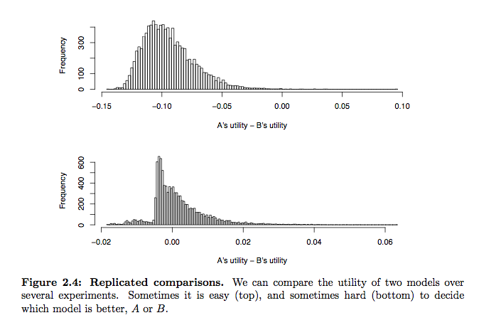
Source: Alex Jakulin’s 2005 Dissertation
Notes:
In the second case (bottom), deciding which model is better becomes a very difficult problem: in the most frequent case (mode), B was better; for the average utility over all experiments, A was better; in the average case (median), B was better; in the best case, A was better; at the worst, B was not as bad. What to do? Deciding between two models may be ambiguous even when the consistent and quantitative utilities are given in full detail. Of course, such a dilemma only arises when the methods are similar in performance: then we could argue that any choice would be fine.

Slide 22
Typical Performance Measures
Simple, naïve
Accuracy, (Cost) Weighted Accuracy
Information Retrieval
Precision, Recall, F-measure
Inter-rater Agreement
Cohen’s Kappa, Scott’s Pi, Fleiss’ Kappa, AC1, Sensitivity, Specificity, Specific Agreement
Signal Processing Theory
ROC
Marketing
LIFT

Slide 23
Precision/Recall/F-Measure
F = 2 * (precision * recall)/(precision +recall)
F is the harmonic mean
General equation for precision/recall
|{rel docs in retrieved docs}| / m
m =
For Recall: |{retrieved docs}|
For precision: |{relevant docs}|

Slide 24
Rules (for being taken seriously)
The “in-sample” data set allows you to construct a model.
The model allows you to predict “out of sample”.
Report and discuss results using the ‘out-of-sample’ predictions. Attempting to generalize from the ‘in sample’ statistics is ‘junk science’.
Advanced note: reporting results against the in-sample predictions does provide some information. It helps you learn whether your model is over-fit. Ask me at the end of the lecture if you want to discuss this.

Slide 25
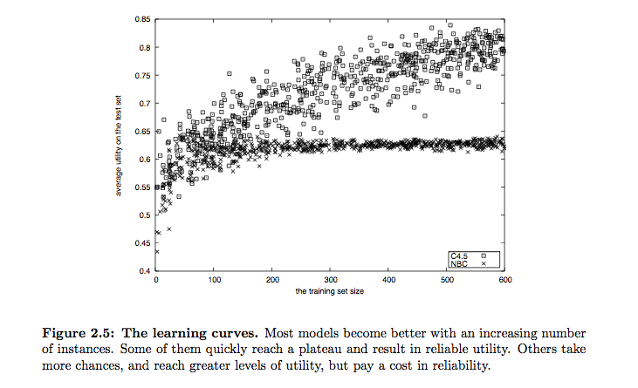
Source: Alex Jakulin’s 2005 Dissertation
Notes:
Building learning curves. Just as cross-validation, bias and variance too depend on the amount of data used for training, and this dependency can be analyzed using learning curves (Kadie, 1995). A learning curve shows the relationship between the performance of a model on unseen data depending on how much data was used for training. If the utility no longer changes, the model has converged and additional data is less likely to affect the model.

Slide 26
Concluding Remark and Questions
Picking a performance metric is usually motivated by the norms of the research field
If you are not constrained by norms, each highlights a different strength or weakness of each hypothesis test.

Slide 27
Appendix
Additional Material

Slide 28
Reading
To work in this space, you need to understand some basic concepts.
Gaussian/Normal distributions
Binomial distributions
Contingency Tables
Confusion Tables

Slide 29
Example Setup
In the following 3 examples, you should assume that you are working on a supervised learning problem. You are attempting to predict whether a newswire story is about sports or not about sports. The entire data set is labeled. You want to build a machine learning system that will predict whether a story (provided by the same news service) is about sports or not.

Slide 30
Example 1
Process:
Sample 100k newswire articles from Google News
Compute IDF for all of the articles
Compute TF-IDF for all articles
Sample 50k articles, use as training set to build classifier
Predict on other 50k articles
Report Performance
Notes:
What are the strengths and weaknesses to this experimental design? Strength: simple; Weakness: computing IDF on all articles instead of just training set is bad form – information leakage. 2-fold cross validation isn’t a lot of perturbation and variance in the composition of the data set. But the data set is large. How is the sample drawn? Unclear from the description. What is the performance metric? The process doesn’t specify how performance is calculated.

Slide 31
Example 2
Process:
Sample 100k newswire articles from Google News
Divide data into 5-folds of 20k each … f[1] … f[5]
SumofMetrics = 0
For i = 1 to 5
Training set = f[1] + f[2] + f[3] + f[4] + f[5] – f[i]
Compute IDF on the Training Set
Compute TF-IDF for all articles
Use training set to build classifier
Predict on f[i] articles
SumofMetrics += Metric(predictions)
AvgOfMetrics = SumofMetrics/5
Report Performance
Notes:
How is the sampling computed? Can the metric be averaged? Is 5-fold validation enough?

Slide 32
Example 3
Process:
Sample 100k newswire articles from Google News
For i = 1 to 1200
TestSet = Random sample w/replacement of 1/5th of the data
Training set = FullSet – TestSet
Compute IDF on the Training Set
Compute TF-IDF on all articles
Use training set to build classifier
Predict on TestSet articles
Insert_into_normal_distribution( Metric(predictions) )
AvgOfMetrics = Mean( normal_distribution)
Variance = Variance( normal_distribution )
Report Performance
Notes:
Is a normal distribution the right way to think about the problem? Lots of processing? Why I = 1 to 1200?

Slide 33
Source: Alex Jakulin’s 2005 Dissertation
Notes:
In the second case (bottom), deciding which model is better becomes a very difficult problem: in the most frequent case (mode), B was better; for the average utility over all experiments, A was better; in the average case (median), B was better; in the best case, A was better; at the worst, B was not as bad. What to do? Deciding between two models may be ambiguous even when the consistent and quantitative utilities are given in full detail. Of course, such a dilemma only arises when the methods are similar in performance: then we could argue that any choice would be fine.

